Slide 1

Highly Interpretable Graph NNs for Real World Multi-Agent Systems
Alex Beyer
Department of Mechanical Engineering
University of Maryland
abeyer@umd.edu

Slide 2
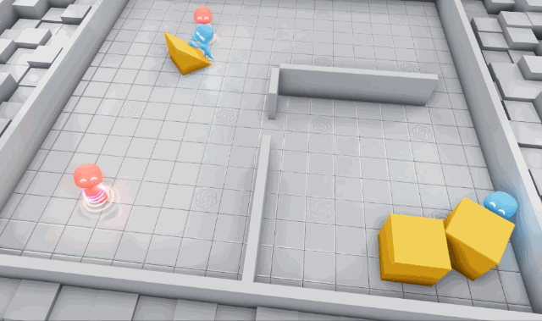
Why Study Multi-Agent Systems?
Multi-Agent (MA) Systems are collections of agents that solve complex problems via coordinated action
Studying these systems also gives insights on emergent group behaviors
MA Systems are all around us!
Self Driving Cars
Logistics Networks
Site/Project Monitoring[1]
Video: openai.com/research/emergent-tool-use
Notes:
We’ve seen single agent systems be applied to real world problems with great results, but many problems are too complicated to be tackled by single robots – these problems typically require groups of agents acting in a coordinated way to solve well (or at all, in some cases)
As humans we are surrounded by MA systems all the time, even if we don’t realize it: self driving cars and logistics networks are two great examples
Studying MA Systems also gives very powerful insights in group dynamics and emergent behaviors, something which has been leveraged a lot recently to explore the dynamics of project teams

Slide 3
Real-World Requirements for MA Systems
Requirement | Definition
Performance | Algorithms must be capable of accurately performing the given task
Interpretability | Algorithms must be able to provide human understandable rationale for actions taken, ideally allowing designers to step through the logic used
Fault Tolerance | MA Systems should maintain performance and safety even as communication quality varies or agents cease functioning
Extensibility | Algorithms should account minor changes in the problem (such as number of agents or changes in constraints) without much work
Transferability | Ideally, a MA framework should be able to handle a variety of problems
Definitions based on the work of [7-9]
Notes:
In general, we can identify 5 main qualities a MA system should have to allow it to function well in real world human environments:
First and most critically, a system must be capable of performing its assigned task accurately and consistently – this issue is well understood, with a variety of groups demonstrating high performance MA algorithms for many tasks
Second, it’s important for safety reasons that we can understand what the system is doing and why. This allows designers to take preventative steps to stop unsafe behavior and diagnose faults after the fact
Equally as important is the idea of Fault Tolerance – that real world effects like varying communication quality and damage to individual agents should not seriously compromise the algorithms performance
An ideal MA algorithm should also function well both as the parameters of it’s problem are changed (like # agents or specific constraints) and be applicable to multiple tasks without significant rebuilding

Slide 4
State of the Art for MA Systems
Two main approaches:
Expert Designed, Model Based Control
Multi-Agent Reinforcement Learning (MARL)
Often makes use of Deep Reinforcement Learning (DRL)
Notes:
With all that said, there are two main approached to solving MA coordination problems:
-Expert Designed, Model Based Controllers which use system dynamics to derive control laws that generate the desired behavior
-Data Driven Multi-Agent Reinforcement Learning, where the agents learn how to achieve a certain goal through interactions with their environments. This approach typically makes use of Deep Reinforcement Learning, a concept we’ll discuss more later
Remove lower half and get a nice picture?
There are other major considerations to this process like the degree to which centralized processing is used to aid the system or heterogeneity of agents, but these end up
Explain DRL here and say we don’t have time to go much into depth – uses ANNs to solve problems involving high dimensional data with complicated rules governing outputs, its great for solving complex problems because it requires comparatively little engineering of its features but the high dimensionality of the network and sheer number of operations involved make it difficult to interpret

Slide 5
Model Based Control
Uses models of system dynamics to derive optimal control laws
Provides robust guarantees of system behavior
Many recent attempts are Constraint-Driven, having been demonstrated for
Collision free navigation via Barrier Functions[2]
Platooning of vehicles on highways[3]
Predator avoidance and emergent flocking[4]
Notes:
The first approach I want to touch on is traditionally designed model based controllers.
As mentioned before, these rely on modeling system dynamics in an attempt to derive a control law – there are many approaches to this but one of the main focuses as of late has been on constraint driven optimal control where desired behaviors are posed as system constraints
This is an approach which been validated on a number of scenarios, from collision free navigation via Barrier Functions and Predator Avoidance to Vehicle Platooning on highways

Slide 6
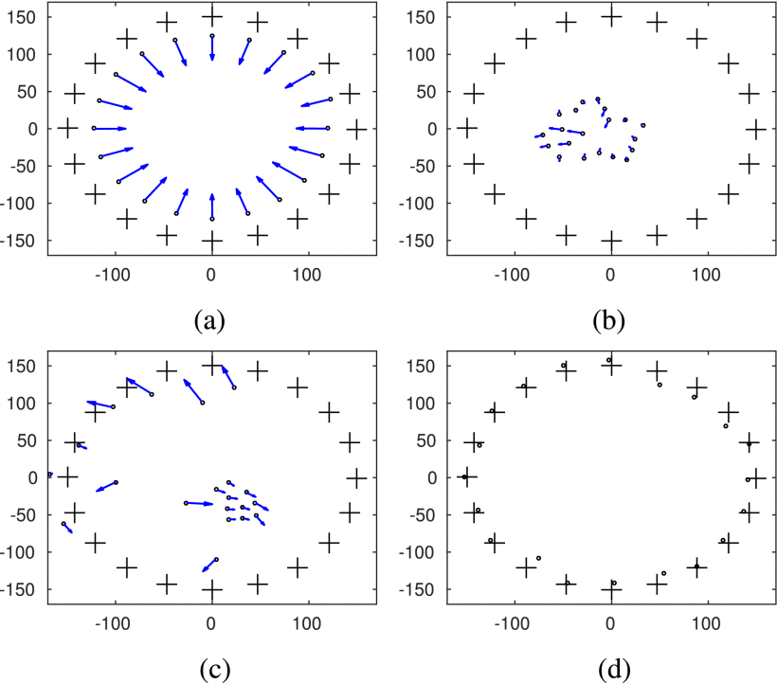
Example: Safety Barrier Certificates[2]
Implements Centralized & Decentralized methods of preventing collision between moving agents as functions of agent accelerations
t = 0
t = 2538
t = 5000
Notes:
In their 2017 paper Wang et al define a safe subset of the joint agent state space and use Control Barrier Functions to ensure all agents stay within this safe set for all future time – this control method is then verified to prevent collision between agents when implemented with specially designed breaking constraints during a simulation of agents trying to cross a circular workspace - a setup which is deliberately meant to cause collisions between agents
See sec 4 for relevant eqns to include

Slide 7
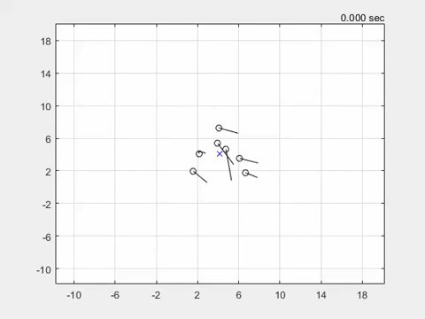
Example: Predator Avoidance and Flocking[4]
[4], video from:
sites.google.com/view/ud-ids-lab/cdflock
Builds a Finite State Machine capable of producing emergent safety behaviors like maintaining minimum distance
Optimizes a single objective function subject to multiple constraints with active constraints depending on state
Notes:
In this example, Malikopolous et al demonstrate the emergence of flocking behavior from a constraint driven optimal control algorithm. Whats interesting about this approach is that flocking behavior is never explicitly defined by a control law; instead emerging from the activation of different constraints as system state changes – this approach allows for the permissible action spaces of agents to be far larger than they would otherwise be if all constraints were always active, easing computation of the controls

Slide 8
Multi-Agent Reinforcement Learning
Many algorithms used such as:
Decentralized Partly Observable Markov Decision Processes(Dec-POMDPs)[6]
Graph Neural Networks (GNNs)[5]
Decentralized Asynchronous Advantage Actor-Critic (A3C)[6]
Evolutionary Algorithms
Notes:
The other main approach we’ll look at it Multi-Agent Reinforcement Learning (MARL)
This is a particularly rich subfield of Reinforcement Learning which has seen an explosion of interest in the past few years, with implementations using and combining many different RL frameworks
Remove the 2nd part and get a picture?

Slide 9
Multi-Agent Reinforcement Learning
Many algorithms used such as:
Decentralized Partly Observable Markov Decision Processes(Dec-POMDPs)[6]
Graph Neural Networks (GNNs)[5]
Decentralized Asynchronous Advantage Actor-Critic (A3C)[6]
Evolutionary Algorithms
Notes:
However, one method has stood out amongst the rest – Graph Neural Networks. Approaches based on GNNs have repeatedly been demonstrated to have incredibly desirable qualities for the control of MA systems, but what are they exactly?
Backup slide exists for extra considerations

Slide 10
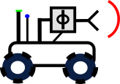
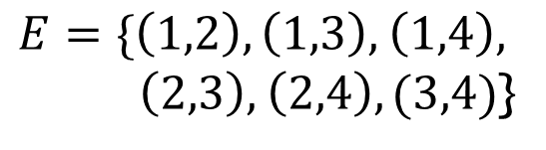
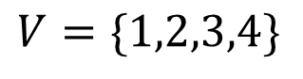
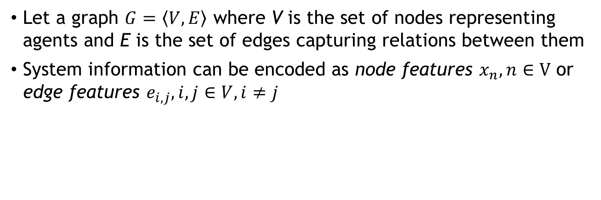
Intro to Graphs and Graph Theory
Let a graph $G=\left\langle V,E\right\rangle$ where V is the set of nodes representing agents and E is the set of edges capturing relations between them
System information can be encoded as node features $x_{n},n∈V$ or edge features $e_{i,j},i,j∈V,i≠j$
2
$$V=\{1,2,3,4\}$$
1
$E=\{\left(1,2\right),\left(1,3\right),$ $\left(1,4\right),$
$\left(2,3\right),$ $\left(2,4\right),(3,4)$}
3
4
See [10] for full explanation
Notes:
First we need to discuss what a Graph is – these aren’t the type of graphs you’re familiar with from [school/MATLAB], but rather ways of capturing information and relationships. For our purposes, we can define a graph as a set G of vertices V corresponding to each agent and a set of edges E storing relational information. Both edges and nodes are capable of having feature vectors, which are just ways of associating certain types of data to them.
Below, we can see an example of translating a MA system into a graph. N this case every agent is capable of communication with every other agent, so every node is connected, which isn’t necessarily true for every system.

Slide 11
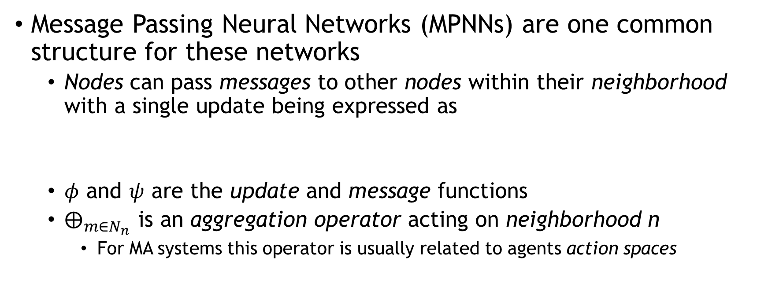
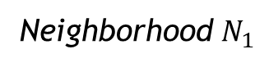
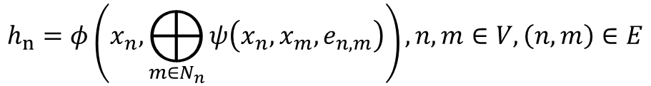
Intro to Graph Neural Networks
Message Passing Neural Networks (MPNNs) are one common structure for these networks
Nodes can pass messages to other nodes within their neighborhood with a single update being expressed as
$φ$ and $ψ$ are the update and message functions
$⨁_{m∈N_{n}}{ }$is an aggregation operator acting on neighborhood n
For MA systems this operator is usually related to agents action spaces
Neighborhood $N_{1}$
$$h_{n}=φ\left(x_{n},⨁_{m∈N_{n}}{ψ\left(x_{n},x_{m},e_{n,m}\right)}\right), n,m∈V,\left(n,m\right)∈E$$
1
2
4
3
5
See [10] for full explanation
Notes:
Now we have a notion of a graph we can begin to apply RL theory to them. GNNs were originally conceived around 2005 with little progress being made until 2017 when Kipf et al presented the first Graph Convolutional Networks, leading to the field growing into what it is today. One of the most common structures for GNNs is something called a Message Passing Network (MPNN) which allows nodes within the same neighborhood to send “messages” to one another based on their respective node and edge features. In general, a single layer of an MPNN can be expressed as an update function φ which takes in the nodes current features and an aggregated message from all nodes within the same neighborhood, which is then used to update the relevant features. By convention, the neighborhood of a node is defined as itself and any nodes one edge away.
There is incredibly rich theory behind how exactly these layers function which I don’t have time to explain fully, but reference 10 is an excellent primer on the topic.

Slide 12
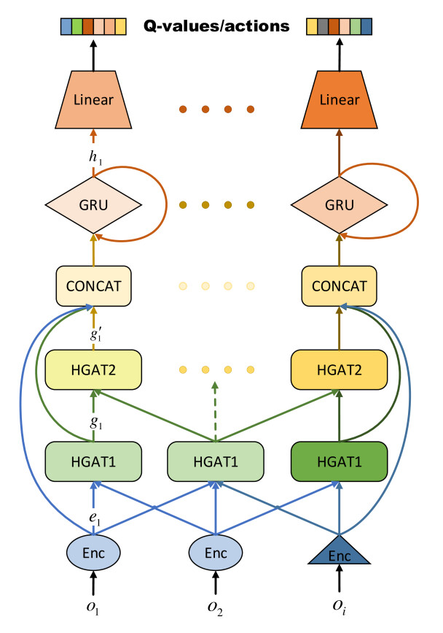
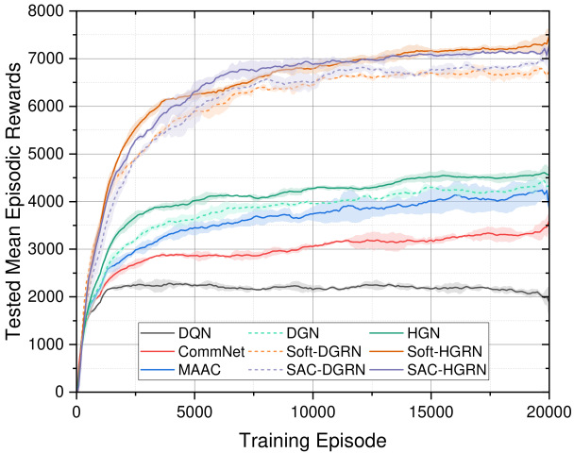
Example: Decentralized GNN based Exploration[5]
Achieves scalable communication schemes via Graph Attention Networks (GATs)
Uses GNNs to teach the model what information to base decisions off as a function of agent spacing and relevancy
Notes:
In this example Ye et al develops a Hierarchichal Graph Recurrent Network (HGRN) which is underpinned by something called a Graph Attention Network (GAT) – a type of MPNN which is actually training itself on how to send messages and which messages to listen to and store in long term memory to aid in exploration
They successfully demonstrate that this type of GNN (and a closely related actor-critic implementation) outperform other state of the art algorithms by as much as 50% after training
GRU is gated recurrent unit, used to store valuable information long term

Slide 13
MARL Vs. Model Based Control
Both methods have advantages
Both are highly performant and can be fault tolerant
Model-Based Control is readily interpretable
MARL is highly extensible and transferable
And roadblocks to implementation
Classical control design makes extensibility and transferability difficult; changing system dynamics or constraints means rederiving controls
The use of DRL for MARL makes interpretability difficult, but this is a very active research area[5,6,7,8,11]
Notes:
So far we’ve laid out two main approaches, but does either one offer a distinct advantage?
Both methods have been demonstrated to be highly performant and tolerant to faults
Model Based Controllers are very easy to interpret due to them having been designed by a human who understands all the involved parts, but fundamentally lack transferability and extensibility, with changes in underlying dynamics and constraints requiring controls to be rederived – a difficult and time consuming process
MARL, by contrast, is incredibly extensible and transferable, only requiring a clear definition of the objective and training time in most cases. However the use of deep learning methods hampers interpretability by obfuscating what the network is actually doing to process an input into an output. That said, recent years have seen an inordinate amount of interest paid to interpreting RL algorithms, with an entire subfield arising around it. With recent advances, it seems as though the interpretability barrier is a problem which can be overcome through clever design and the use of modern RL tools to yield the kind of safety guarantees needed for safe real world implementation – even if many of these approaches haven’t been fully explored in relation to MA systems yet

Slide 14
Model Interpretability - Dimensions
Many metrics are difficult to quantify and there’s no definitive set!
Requirement | Definition
Transparency | Choosing model representations which have well understood properties and intuitive representation of different features
Simulatability | The ability to break a model into subsystems with understandable inputs and outputs
Decomposability | Understanding the way model components process data
Consistency | Similar inputs should lead to similar outputs
Based on work of [7,8,11]
Notes:
In general, I see Interpretability coming from 4 different qualities of a model:
A good model is transparent; it has well understood properties and represents data in a way humans can understand
Being able to simulate a model as a collection of simpler subsystems is also important, as well as being able to understand how all the parts of that decomposition function. Taken together, this allows designers to deconstruct complicated deep learning models into simple parts to better understand the input-output relationship.
Finally, a good model ought to be consistent; small variations in input should lead to small variations in output
Two things are also worth noting with this: these metrics are largely qualitative and theres no one universal agreed upon set, this is the set of them I’ve found the most intuitive and useful
Saliency
Identifying why a given input maps to a given output

Slide 15
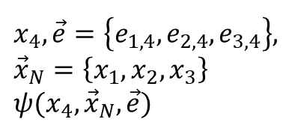
MARL Interpretability – State of the Art
Many methods have been used such as
Imitation Learning of Proxy Models[12]
Example Based Explanations[5,11]
Specific Model and Objective Design[6,11]
GNNs offer two main advantages for Interpretability of MA Systems
Transparent Representations of Data[13]
Easy to Decentralize[14]
4
$$x_{4}, \vec{e}=\left\{e_{1,4},e_{2,4},e_{3,4}\right\}, \\ {\vec{x}}_{N}=\left\{x_{1},x_{2},x_{3}\right\} \\ ψ(x_{4},{\vec{x}}_{N},\vec{e})$$
2
1
4
3
Notes:
Like I said before, a number of groups have been focused on this problem as of late, coming up with clever ideas like training secondary interpreter models to help give human interpretable reasoning for what a deep learning model is doing.
Where GNNs excel in this regard is their ability to offer both transparent, understandable representations of data and the fact that their structure (particularly for MPNNs) is readily decentralizeable
Add some kind of diagram to show the decentralizeability?

Slide 16
Highly Interpretable Graph NNs for Safe Real World Multi-Agent Systems
Problem: MARL approaches lack the interpretability needed for safe implementation in real world human environment
Motivation: Interpretability and safety are intrinsically connected; a safe system is an interpretable one and designers can’t guarantee the safety of uninterpretable systems
Goal: Demonstrate an ability to consistently interpret the behaviors of systems governed by GNNs
Notes:
One clear gap in the current research is that MARL methods have been proven to have a lot of desirable qualities, but at the moment a lack of interpretability makes safely implementing these systems in real world human environments very difficult
My proposal is to build on progress made towards interpreting reinforcement learning more generally to develop a specific framework to aid in interpretation of GNNs for MA applications.

Slide 17
Highly Interpretable Graph NNs for Safe Real World Multi-Agent Systems - Approach
Equipment
Fleet of Unmanned Vehicles with communications and processing hardware
Unmanned drones with similar hardware for heterogeneity tests
Proposed GNN Application
Coordinating Inter-Agent Communication for Pathfinding in Partially Observable Environments – similar to work done in [15]
Agents are equipped with necessary low-level controllers to facilitate motion
Notes:
The equipment needed for this project are a fleet of heterogenous unmanned agents with the hardware required to enable communication and data processing
The particular task I’m interested in exploring is pathfinding in partially observable real world environments. This is a very difficult coordination task owing to the environments being unstructured and possibly dynamic – it is also a task that GNNs have demonstrated abilities to solve, albeit with many current attempts doing so in highly controlled lab environments where the lack of interpretability matters less. In keeping with the way many groups have attempted this problem, GNNs will be used to facilitate communication and coordination between the agents, wile the agents themselves are equipped with low-level controllers to facilitate motion.
Communication coordination is one of the more common applications of GNNs for MARL

Slide 18
Highly Interpretable Graph NNs for Safe Real World Multi-Agent Systems - Timeline
Year 1, Q1-2
Develop and verify interpretability metrics
Year 1, Q3-4
Deployment in unstructured but controlled real world settings
Year 2
Extend to more realistic, totally unstructured human environments
Tests in simulation and structured lab environments
Comparison against existing state-of-the-art metrics
Rigorously verify that interpretability is maintained in more complex environments
Begin controlled Human-Robot interaction tests to ensure safety and robustness of metrics
Slowly allow more uncontrolled interactions to test model limits
Develop robust, interpretable model failsafes
Ensure all failsafes work as intended
Recheck all failsafes before allowing for more interaction between humans and agents
Apply metrics to real world heterogenous systems
Review of relevant literature to identify state of the art GNN architectures and current best methods for improving DRL and NN Interpretability
Explore framework performance for Centralized Training with Decentralized Execution (CTDE) and Decentralized Training and Execution (DTDE)
Reverify performance in CTDE and DTDE regimes
Notes:
The proposed project will be split into three phases over two years:
Phase 1 will take 6 months and be focused on understanding the state of the art for RL interpretability and extending it to the kind of GNN used in this problem, with the aim of creating a set of metrics which allow for clear interpretations of model behavior. As a part of this, a set of model failsafes will be implemented to ensure that the system not only acts safely, but it able to do so in a way a human can understand.
Phase 2 occurs in the latter half of the first year, being largely focused on application to unstructured environments outside of lab while taking care to avoid uncontrolled interaction between agents and humans while the overall safety of the model is ensured. During this phase controlled HRI will be allowed to verify the work to date.
Finally, phase 3 will take the 2nd year of the project and revolve around scaling up to real world, unstructured human environments. At this stage the focus is primarily on ensuring robustness of both metrics and failsafes in the kind of environment this research would be applied to in the real world.
CTDE enables agents to train by taking the information of every agent into account while DTDE does not
DTDE leads to an environment which looks nonstationary from the perspective of a single agent, degrading its ability to learn from interaction but enabling online learning – for real world implementation real world learning is incredibly important
This nonstationarity can, in some cases, lead to models learning more complicated (And thus harder to interpret) policies

Slide 19
Questions?

Slide 20
References
tinyurl.com/ABQERefs
[1] L. Xiang, Y. Tan, G. Shen, and X. Jin, “Applications of multi-agent systems from the perspective of construction management: A literature review,” Eng. Constr. Archit. Manag., vol. 29, no. 9, pp. 3288–3310, Nov. 2022, doi: 10.1108/ECAM-01-2021-0038.
[2] L. Wang, A. D. Ames, and M. Egerstedt, “Safety Barrier Certificates for Collisions-Free Multirobot Systems,” IEEE Trans. Robot., vol. 33, no. 3, pp. 661–674, Jun. 2017, doi: 10.1109/TRO.2017.2659727.
[3] L. E. Beaver and A. A. Malikopoulos, “Constraint-Driven Optimal Control of Multi-Agent Systems: A Highway Platooning Case Study,” IEEE Control Syst. Lett., vol. 6, pp. 1754–1759, 2022, doi: 10.1109/LCSYS.2021.3133801.
[4] L. E. Beaver and A. A. Malikopoulos, “Constraint-Driven Optimal Control for Emergent Swarming and Predator Avoidance.” arXiv, Mar. 21, 2022. Accessed: Mar. 02, 2023. [Online]. Available: http://arxiv.org/abs/2203.11057
[5] Z. Ye, X. Jiang, G. Song, and B. Yang, “Soft Hierarchical Graph Recurrent Networks for Many-Agent Partially Observable Environments.” arXiv, Sep. 05, 2021. Accessed: Mar. 03, 2023. [Online]. Available: http://arxiv.org/abs/2109.02032
[6] G. Sartoretti, W. Paivine, Y. Shi, Y. Wu, and H. Choset, “Distributed Learning of Decentralized Control Policies for Articulated Mobile Robots,” IEEE Trans. Robot., vol. 35, no. 5, pp. 1109–1122, Oct. 2019, doi: 10.1109/TRO.2019.2922493.
[7] C. Glanois et al., “A Survey on Interpretable Reinforcement Learning.” arXiv, Feb. 24, 2022. Accessed: Mar. 02, 2023. [Online]. Available: http://arxiv.org/abs/2112.13112
[8] F.-L. Fan, J. Xiong, M. Li, and G. Wang, “On Interpretability of Artificial Neural Networks: A Survey,” IEEE Trans. Radiat. Plasma Med. Sci., vol. 5, no. 6, pp. 741–760, Nov. 2021, doi: 10.1109/TRPMS.2021.3066428.
[9] M. Dorigo, G. Theraulaz, and V. Trianni, “Reflections on the future of swarm robotics,” Sci. Robot., vol. 5, no. 49, p. eabe4385, Dec. 2020, doi: 10.1126/scirobotics.abe4385.
[10] M. M. Bronstein, J. Bruna, T. Cohen, and P. Veličković, “Geometric Deep Learning: Grids, Groups, Graphs, Geodesics, and Gauges.” arXiv, May 02, 2021. Accessed: Mar. 07, 2023. [Online]. Available: http://arxiv.org/abs/2104.13478
[11] Y. Zhang, P. Tiňo, A. Leonardis, and K. Tang, “A Survey on Neural Network Interpretability,” IEEE Trans. Emerg. Top. Comput. Intell., vol. 5, no. 5, pp. 726–742, Oct. 2021, doi: 10.1109/TETCI.2021.3100641.
[12] J. Blumenkamp and A. Prorok, “The Emergence of Adversarial Communication in Multi-Agent Reinforcement Learning”.
[13] J. Sheng et al., “Learning structured communication for multi-agent reinforcement learning,” Auton. Agents Multi-Agent Syst., vol. 36, no. 2, p. 50, Oct. 2022, doi: 10.1007/s10458-022-09580-8.
[14] J. Blumenkamp, S. Morad, J. Gielis, Q. Li, and A. Prorok, “A Framework for Real-World Multi-Robot Systems Running Decentralized GNN-Based Policies,” in 2022 International Conference on Robotics and Automation (ICRA), Philadelphia, PA, USA, May 2022, pp. 8772–8778. doi: 10.1109/ICRA46639.2022.9811744.
[15] E. Seraj, “Learning Efficient Diverse Communication for Cooperative Heterogeneous Teaming,” 2022.
[17] A. R. Wagner, “Robot-Guided Evacuation as a Paradigm for Human-Robot Interaction Research,” Front. Robot. AI, vol. 8, p. 701938, Jul. 2021, doi: 10.3389/frobt.2021.701938.
[18] A. D. Ames, X. Xu, J. W. Grizzle, and P. Tabuada, “Control Barrier Function Based Quadratic Programs for Safety Critical Systems,” IEEE Trans. Autom. Control, vol. 62, no. 8, pp. 3861–3876, Aug. 2017, doi: 10.1109/TAC.2016.2638961.

Slide 21
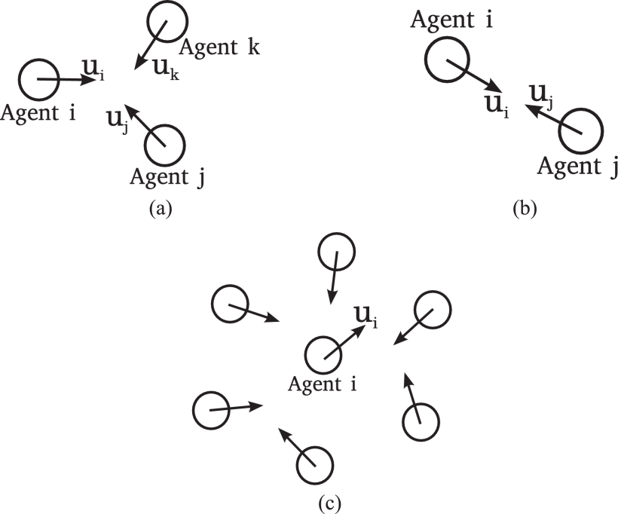
Example: Safety Barrier Certificates[2]
Also investigates the problem of deadlock in these systems, where control laws lead to system states which can’t resolve absent extra logic
Type I
Type II
Type III
Notes:
Interestingly, the use of ZCBFs and a set theoretic approach also yields methods with which to solve deadlock: it turns out Type I and II deadlock correspond to being on a vertex or edge of the defined ‘safe set’, respectively while type III corresponds to an agent for whom the safe set of control actions has shrunk to nothing, leaving it stuck until other nearby agents resolve their deadlocks

Slide 22
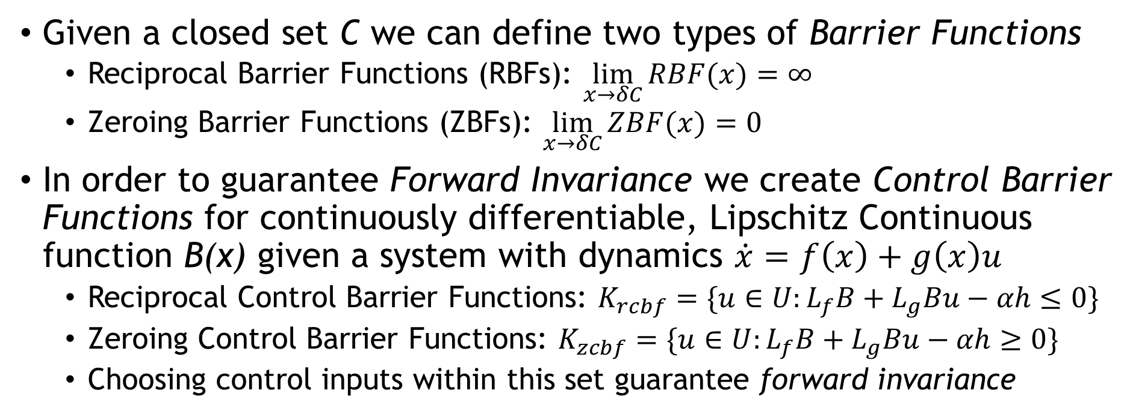
Control Barrier Functions and Certificates[18]
Given a closed set C we can define two types of Barrier Functions
Reciprocal Barrier Functions (RBFs): $\lim_{x→δC}{RBF(x)}=∞$
Zeroing Barrier Functions (ZBFs): $\lim_{x→δC}{ZBF(x)}=0$
In order to guarantee Forward Invariance we create Control Barrier Functions for continuously differentiable, Lipschitz Continuous function B(x) given a system with dynamics $\dot{x}=f\left(x\right)+g\left(x\right)u$
Reciprocal Control Barrier Functions: $K_{rcbf}=\{u∈U:L_{f}B+L_{g}Bu−αh≤0\}$
Zeroing Control Barrier Functions: $K_{zcbf}=\{u∈U:L_{f}B+L_{g}Bu−αh≥0\}$
Choosing control inputs within this set guarantee forward invariance
Notes:
Forward Invariance sets of a dynamic system are sets In which solutions beginning in them never leave the set
When applied a Barrier Function can guarantee that the dynamic systems state will never depart a desired set (usually the one it started in) and can be used to quantify system safety or the idea that it can avoid entering any potentially unsafe or undesired sets in the future
Barrier Certificates and Barrier Functions are used synonymously
Barrier Functions in general are analogous to Lyapunov functions for stability; just like any stable system has an associated Lyapunov Function any system which can be demonstrated to be safe has a barrier function

Slide 23
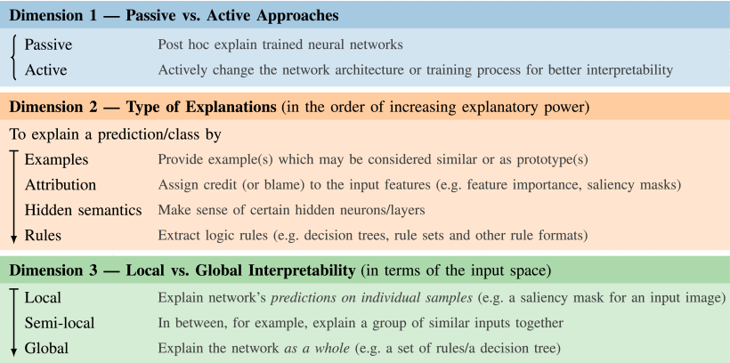
Model Interpretability – Taxonomy[11]
Notes:
breaks interpretability into two terms: 1 - explanations which are the logical decision rules used by agents to pick actions 2 - understandable terms which means the algorithm is working with human-understandable data to make decisions
NNs must be interpretable because: 1 - reliability depends on our ability to tell why something went wrong, not just that it did 2 - uninterpretable NNs have uninterpretable bias which leads to major ethics issues 3 - in order to use NNs for scientific tasks its important to know hwy they do things
3 dimensions to interpretability: 1 - passive vs active i)passive - post hoc explanations for actions taken ii)active choices about network architecture to make things more interpretable 2 - type of explanatioion (in order of increasing power) i) examples which can inform decision making ii) attribution of failures to specific input features iii) semantics which allow the user to make sense of the inner workings of the DNN iv) logical rules uses to make decisions 3 - local v global i) explain how the network makes decisions on singular examples ii) explain how grups of inputs effect the decisoin making process iii) explain the overall decision making process in every case

Slide 24
Agent Heterogeneity & GNNs
Often useful for MA systems to have multiple agent types:
Drones & Ground Vehicles for Search and Rescue
Long & Short Range Logistics Robots
Allows for flexibility in how problems are solved at the cost of complexity[15]
GNNs account for this in a few ways, depending on implementation:
Feature Vectors and Action Spaces of different lengths
Parameter Initalizations

Slide 25
MARL Structure Considerations
Centralization vs Decentralization
Centralized Training, Decentralized Execution (CTDE)
Decentralized Training, Decentralized Execution (DTDE)
Heterogeneity
Agents with different abilities often improve overall performance
Problem Decomposition
Global vs Local Objectives
Agent State Observability
Information Security

Slide 26
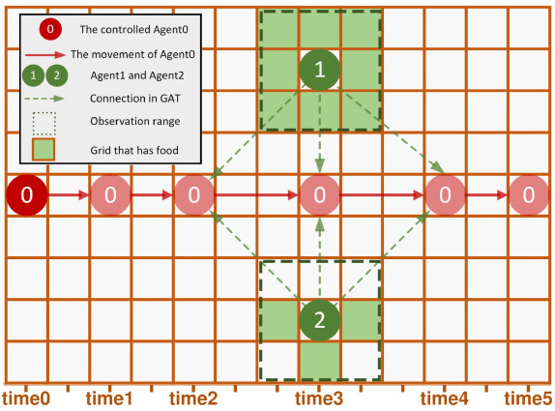
Example: Interpretability for Decentralized GNN based Exploration[5]
Achieves a level of interpretability by using example cases
In this example the attention component of the HGRN is studied as a mobile agent moves between two fixed agents – the GNN begins to pay attention once the agents are close enough for communication to occur without significant loss
Notes:
demonstrates a highly interpretable, scalable and transferable GNN for use in partially observable MA systemsonly demonstrates this in siomulated environments
achieves beter interpretability by having the policy learn agent action entropy which is equivalent to the exploration rate of the policy
each agent is a node with its embedding depending on the local observations, connected to other nodes as aufnciotn or prior knowledge, a hierarchical graph attention network (HGAT) is used to ensure communication between heterogenous agents
in all cases the HGAT greatly outpreforms all other tested methods (like DQN, DGN and CommNet, another GNN based approach) by pretty wide reward margins - these rewards dont translate well into human intelligible quantities though
they benchmark interpretability by exploring some case studies, like exploring the attention weights of a particular sim case where they discover that the model initial starts off by paying a lot of attention to the agent reaping the highest reward before transition to relying mostly on its own memory once the model has begun to learn a policy transferrability is approached in a similar way by training the model for one number of agnet,s then varying the number of agents its tested with, its found that the learned policies are particularly transferable as the number of agnets rise - how does this compre ot expert methiods?

Slide 27
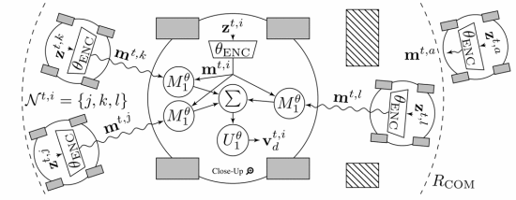
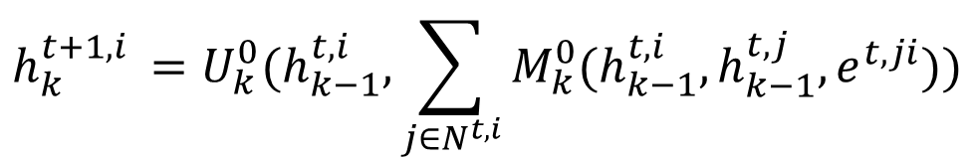
Example: Learning Heterogenous Communication Structures via GNNs[14]
Blumenkamp, et al. propose a GNN structure which allows heterogenous agents to form graphs based on separation and communication distance, updated as:
$$h_{k}^{t+1,i }=U_{k}^{0}(h_{k−1}^{t,i },\sum_{j∈N^{t,i}}{M_{k}^{0}(h_{k−1}^{t,i},h_{k−1}^{t,j},e^{t,ji}))}$$
GNNs Learn to form Ad-Hoc Communication Networks
[15]
Notes:
present a GNN scheme to control real world robots via ad-hoc communication in a lab environment with the goal of navigating an environment with an obstacle in the way that forces coordintion to overcome GNNs are inherently decentralizeable
expirimentally verifies the ability to create decentralized GNN based goal postiion seeking MA systems based on ad-hoc communication
this problem studies fixed environments where the agents only know their own positions adn velocities and must communicate with one another to coordainte motion and avoid collisions, this method can also run at varying level of decentralization (and has been tested in a fully decentralized setup)
the paper does not addess model interpretability at all

Slide 28
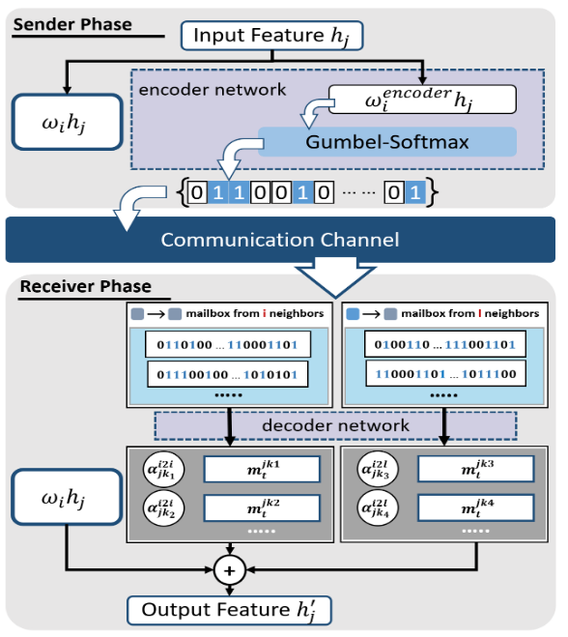
Example: Learning Policies for Heterogenous Teaming[15]
Single Send-Receive Update Phase for a single HetGAT agent
Extends GATs to Heterogenous MA Systems
Realized large performance gains (as much as 434%) over baselines
Achieved by allowing the network to learn a set of Attention Weights for each agent class
Many previous models didn’t explicitly differentiate between different agent classes
Notes:
To send messages agents feed their inputs through a class specific weight matrix and a shaping matrix to fit the expected message dimension for each type of receiver, then get binarized by the Gumbel Softmax before being sent
When messages are rec’d the network processes all rec’d messages through a class specific decoder and then aggregates messages by type of edge connection, weighted with normalized attention coefficients. The aggregation results are used to update the node embedding and output features
-------
builds a GNN capable of facilitating coordination and communication between decentralized heterogenous MA systems which not only facilitates the learning of heterogenous MA policies but also achieves massive reductions in communications bandwidth while simultaneously achieving large performance improvments over other state of the art networks
extends many older frameworks to include heterogenous graphs where nodes and edges are capable of having different properties from one another as well as supporitng the creation of new edges on the fly
demonstrates performance on structured simulated environments experiences perfroamcne degradation as they move away from centralized planning due to the added difficulty of communication, but is able to find ways of improving perfroamnce by changing communicaiton schemes
does not address interpretability/intelligibility

Slide 29
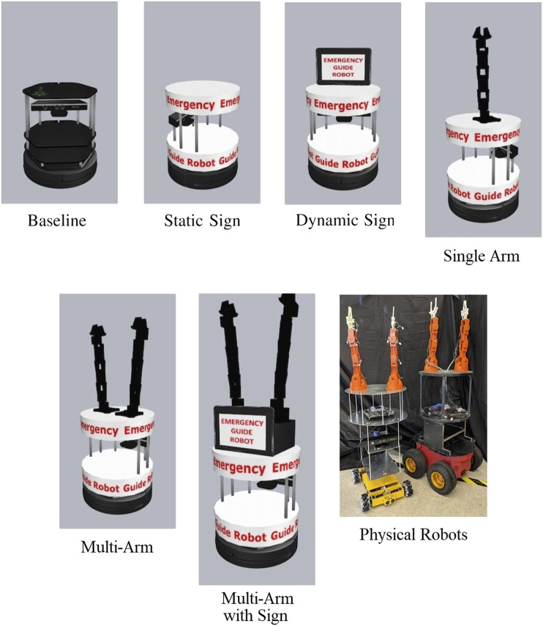
Example: Interpretability Limiting Human-Robot Interactions[17]
In this study A. Wagner investigates the potential application of MA systems to Evacuations
Identifies that shepherding robots are the most effective, but are currently lacking robust safety guarantees needed for implementation
Main obstacles:
Dynamic/Changing Environments
Uninterpretable Models leading to unpredictable behavior
Notes:
explores HRI in the case of emergency evacuation and details necessary design considerations which need to be consistently met in a predicatable way
pg3,4 - multiagent evcuation algorithms have yet to be expirimentally validated due t a lack of robust coordinated plannign strategies and studies into human interaction, however there do exist multiagent strategies where each agent sets up a static checkpoint and tries to direct people to the next checkpoint -- a lack of the exact kind of guaruntees i was thinking of!!
pg6,7 - another potential method for evacuation via multiple agents is to have agents find groups of evacuees and attempt to shepherd them away from danger, however this becomes very difficult to do reliably due to the potential variability in the evrionment leading to a robot doing unexpected things and the overall complexity of the task. its also possible to combine the two methods (serving as passive waypoints at first before switching modes to shepherd people away from danger) but this has the same pitfalls as shepherding while also introducing the inter-agent coordination problem of mode switching
finds that using robots as authoritative actors when evacuation is necessary gives good results in terms of getting people out but struggles to deal with larger builds, shifting environments and many people

Slide 30
Reinforcement Learning
New State
Environment
State Interpreter
Reward
State
Agent
Action
(State, Action, Reward)
Parameter Update

Slide 31
Neural Networks
Hidden Layer
Input Layer
Takes a set of arbitrarily dimensioned inputs which are then fed through hidden layers of nodes which are linear functions with weights applied to edge inputs
Can have as many hidden layers as necessary
NNs are proven to be universal function approximators
Output Layer
Single Layer Feedforward NN

Slide 32
Graph Neural Networks
Differ from NNs in a few ways:
Iterate through the network one node at a time
Features and weights are associated with both edges and nodes
Edges can be uni- or bidirectional
As such, GNNs can be trained for:
Node Level Tasks
Edge Level Tasks
Graph Level Tasks
Graph of a GNN
More details in [10]

Slide 33
What makes Reinforcement Learning Deep?
Fully Connected Layer 2
Fully Connected Layer 1
Hidden Layer
Input Layer
Input Layer
Output Layer
Output Layer
Feedforward NN
Feedforward Deep NN

Slide 34
CTDE and DTDE
Environment
Environment
Training Data
Agent 1
Agent n
Agent 1
Agent n
Update
Update
Update
Update
CTDE: Agents share training data which is discarded at runtime, preventing online learning
DTDE: Agents do not share training data, allowing online learning
Notes:
CTDE enables agents to train by taking the information of every agent into account while DTDE does not
DTDE leads to an environment which looks nonstationary from the perspective of a single agent, degrading its ability to learn from interaction but enabling online learning – for real world implementation real world learning is incredibly important
This nonstationarity can, in some cases, lead to models learning more complicated (And thus harder to interpret) policies

